Slide 1
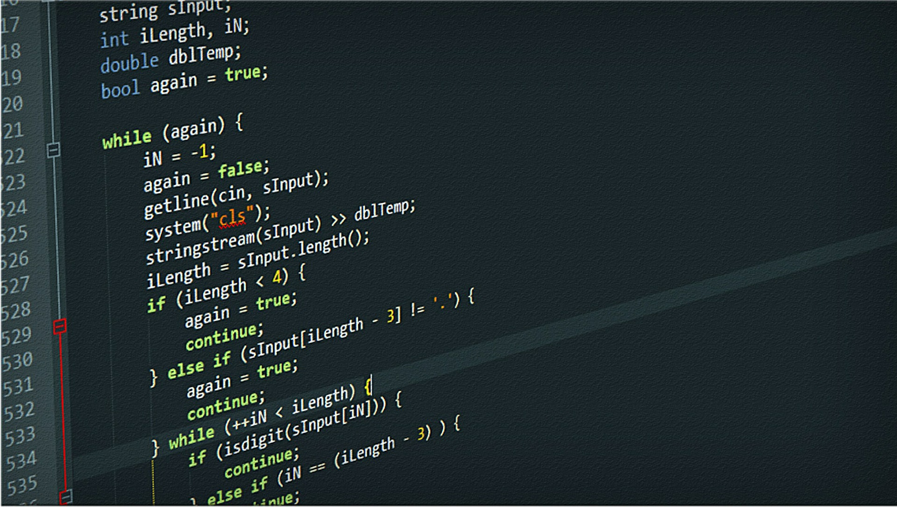
CRASH COURSE ON C
Enrico Bertolazzi
Master ADBoT - May 2019
Enrico Bertolazzi

Slide 2
C language origin
Developed at Bell Laboratories (begin of 70) by Dennis Ritchie (a pioneer of UNIX)
First implementation on DEC PDP-11 on UNIX OS
By many year the “De-Facto Standard” of the language is contained in the book by Kernighan e Ritchie.
In 1983 the ANSI committee define the first standard for C language
Next evolved in C89, C90, C95, C99, C11, C18
Master ADBoT - May 2019
Enrico Bertolazzi

Slide 3
C features
Is an intermediate level language
Its easy to combine high level formalist with low level instruction (like the assembly)
Easy low level manipulation of bit, byte, word pointers
C is target for OS development and/or hardware interface
C for many year was a good choice for the development of general purpose library, compilers, OS, low level interface driver, …
Master ADBoT - May 2019
Enrico Bertolazzi

Slide 4

C characteristic
C is a structured language
C has the ability to store information and use instruction that are hidden
C is primitive language
No feature are built in in the language
I/O is done by libraries
MATH is done by libraries
STRING manipulation is done by libraries
…
C is a compiled language
There are dialect of C that are interpreted
https://gitlab.com/zsaleeba/picoc (PICO C)
http://www.softintegration.com (CH interpreter)
C is free (mainly)
The C compiler is universally availble in any OS, the GNU C is available virtually on any hardware.
Master ADBoT - May 2019
Enrico Bertolazzi

Slide 5
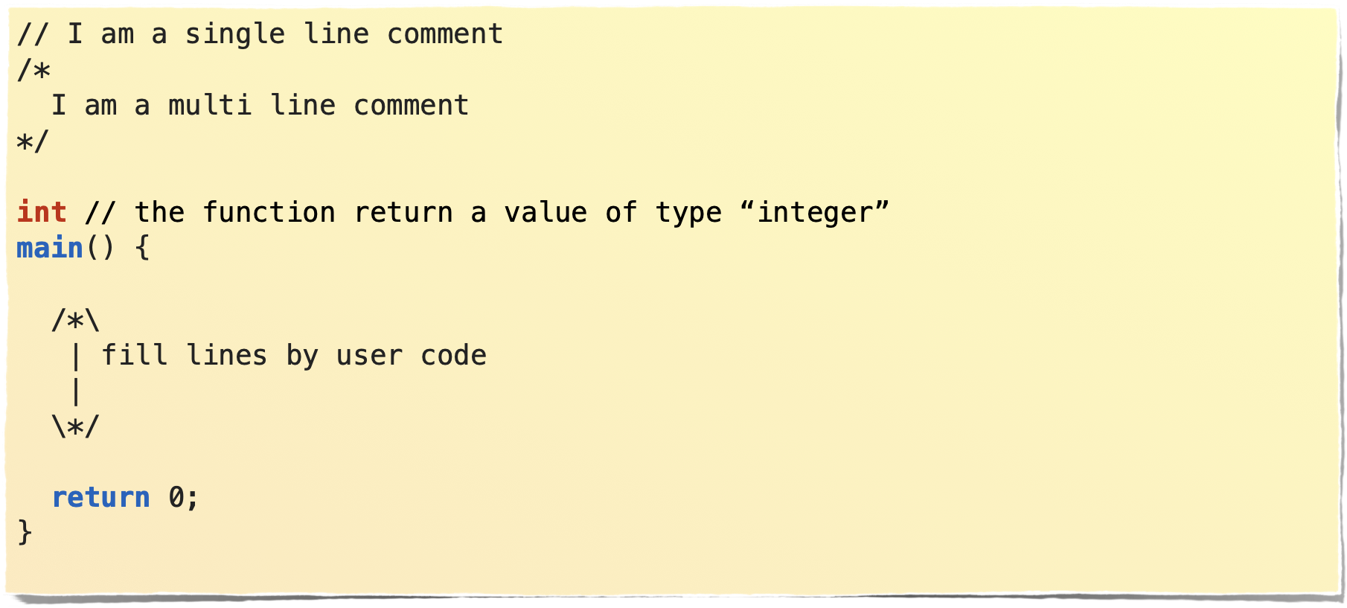
C main program
A C program consists of a single function named main.
The function must return an integer
Master ADBoT - May 2019
Enrico Bertolazzi

Slide 6

C basiC DATA TYPE aND OPERATOR
Master ADBoT - May 2019
Enrico Bertolazzi

Slide 7
C keywords
Type of data
void, char, int, float, double, enum, struct, union
Modification of data size/storage
signed, unsigned, short, long, extern, static, register, cost, volatile
Conditions and loops
if, else, do, while, for, continue, break, goto, switch, case, default
Operatos
assign, =, logical || (or) && (and), ! (negation)
arithmetic, +, -, *, /, % (remainder only for integer)
comparison >, <, >=, <=, ==, !=
bit manipulation, &, |, ~, >>, <<
Other keywords
main, return, typedef, sizeof
Master ADBoT - May 2019
Enrico Bertolazzi

Slide 8
Size of mainly used data
Data Type | Keyword | Size
character | char | Generally 1 byte
integer | int | Generally 4 bytes
floating point | float | Generally 4 bytes
double floating point | double | Generally 8 bytes
valueless | void | no size
Master ADBoT - May 2019
Enrico Bertolazzi

Slide 9
Size modifier
Modifier | apply to
long | int, double
short | int
signed | char, int
unsigned | char, int
Notice that
unsigned int
can be shorted to
unsigned
short int and long int
can be shorted int
short and long
respectively
Master ADBoT - May 2019
Enrico Bertolazzi

Slide 10
memory storage specification
extern
In front of a variable declaration specify that the data is not stored in this unit but somewhere else. The data will be available to the unit code after the linking phase
static
The data is available ONLY on the function in the specific source code. No external symbol are generated
register
Suggest to the compiler that the data is important and must be stored in a manner as fast as possible, for example store it on a CPU register
Master ADBoT - May 2019
Enrico Bertolazzi

Slide 11
Extra information on data
const
Declare the contest of the data is not modified in the current function/program. This can help compiler optimization.
volatile
The data declared volatile can change without the code explicitly access it. This is the case for example of accessing memory related to hardware units.
Master ADBoT - May 2019
Enrico Bertolazzi

Slide 12
Constants
characters
a character is defined a letter/number between quote, e,g,
‘a’, ‘h’, ‘1’
special ascii character like new line, tab have special code prefixed by \
‘\n’ new line
‘\t’ tab
‘\r’ return
any ascii code can be inserted with \ followed by 0N where N is an octal integer. For example the ascii character ‘+’ that correspond to the ascii character number 43 (56 in octal) can be accessed with ‘\056’
strings
are simply a consecutive sequence (array) of character terminated by the special character ‘\0’ (zero). They are denoted by double quote:
“mikey mouse”
“pluto” ( ‘p’, ‘l’, ‘u’, ’t’, ‘o’, ‘\0’ )
Master ADBoT - May 2019
Enrico Bertolazzi

Slide 13
Constants
integer
are written as usual, can specify special end character to define unsigned (U) long (L), long long (LL)
123 (normal integer)
123U (unsigned integer)
123UL (unsigned long integer) 123L (signed long integer)
Special prefix are used to insert octal or exadecimal number
0xFF (the number 255 in decimal notation 15+16*15)
077 (the number 63 in decimal notation 7+8*7)
floating point number
constant number with dot are by default double precision (double), single precision (float) must be terminate by f
123.0 (double number) 123f or 123.0f (float number)
Master ADBoT - May 2019
Enrico Bertolazzi

Slide 14
String constants
Character | Meaning
\b | Backspace
\0 | Null
\f | Form feed
\\ | Backslash
\n | New line
\v | Vertical tab
\r | Carriage return
\a | Alert
\t | Horizontal tab
\NNN | NNN Octal constant
\" | Double quote
\xNN | Hexadecimal constant
\' | Single quote
C has not an intrinsic string type (no operation on strings are defined at language level)
C permits to define compactly sequence of character (null terminated) to be used as string
The notation is a double quoted sequence of characters
Master ADBoT - May 2019
Enrico Bertolazzi

Slide 15
Bit Manipulation
Operator | Meaning
& | AND
| | OR
>> | Shift right
<< | Shift left
^ | Exclusive OR
~ | One's complement
Master ADBoT - May 2019
Enrico Bertolazzi

Slide 16
Extra operators
sizeof
pseudo function, return at compile time the size of the argument in bytes
&
return the address of the operand
*
in front of a pointer or address deference the data (get the content of teh pointed data)
, (comma)
used to combine expression contained between ( and ).
. (dot)
access the field of a structure
(type)
Casting operator, reinterpret or convert a data
Master ADBoT - May 2019
Enrico Bertolazzi

Slide 17
C shortcut
Shortcut | Expanded
a += b | a = a+b
a &&= b | a = a && b
a <<= b | a = a << b
Master ADBoT - May 2019
Enrico Bertolazzi

Slide 18
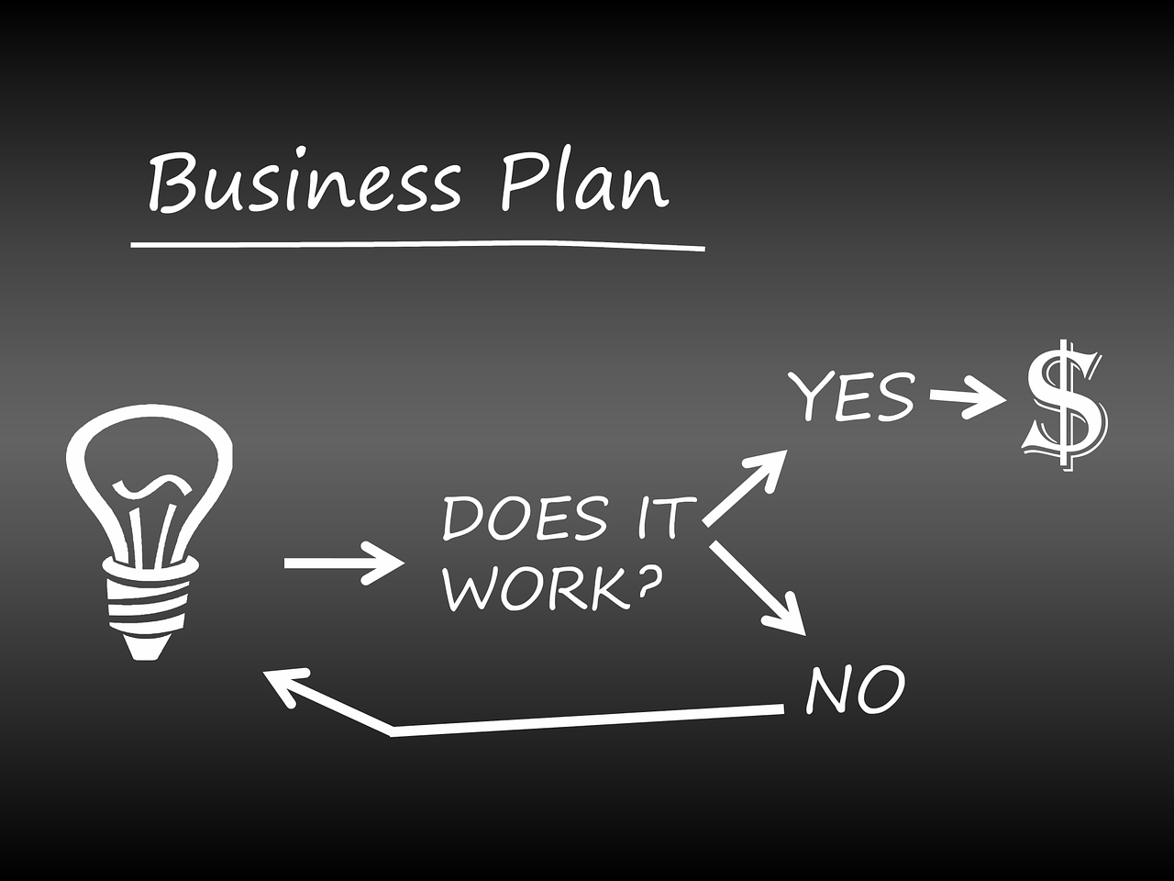
C flux control
Master ADBoT - May 2019
Enrico Bertolazzi

Slide 19
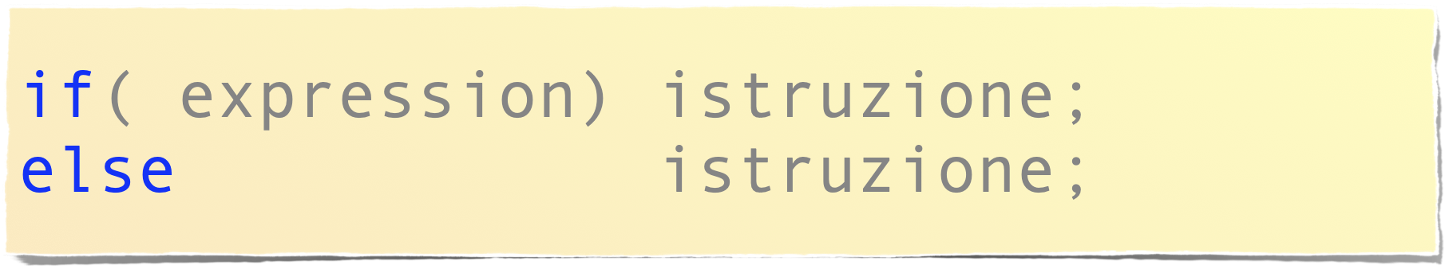
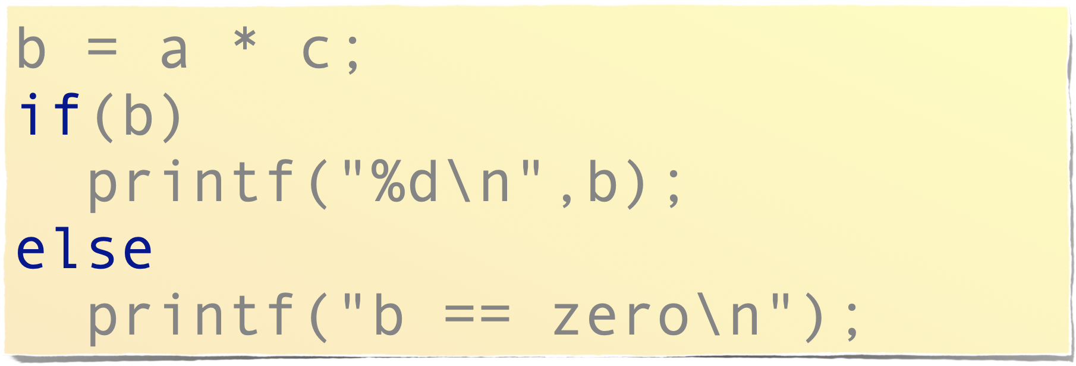
The “if”
Example
Master ADBoT - May 2019
Enrico Bertolazzi

Slide 20
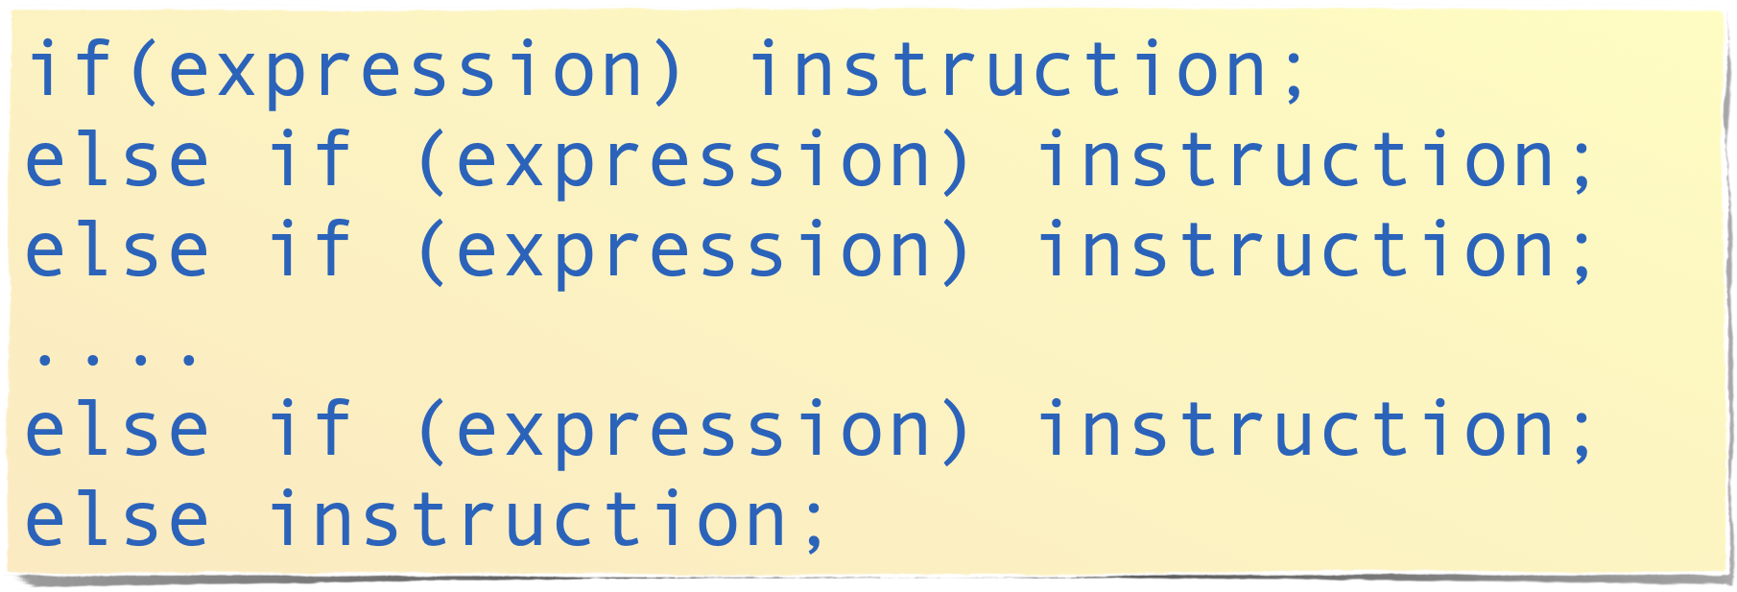

The “if” combined with
multiple else
Instruction ca be also a block
{
instruction;
instruction;
instruction;
}
Master ADBoT - May 2019
Enrico Bertolazzi

Slide 21
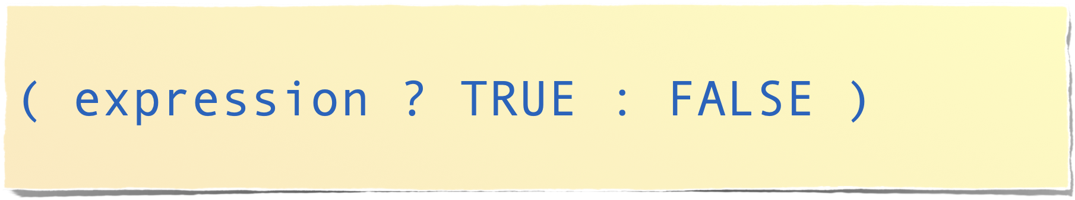
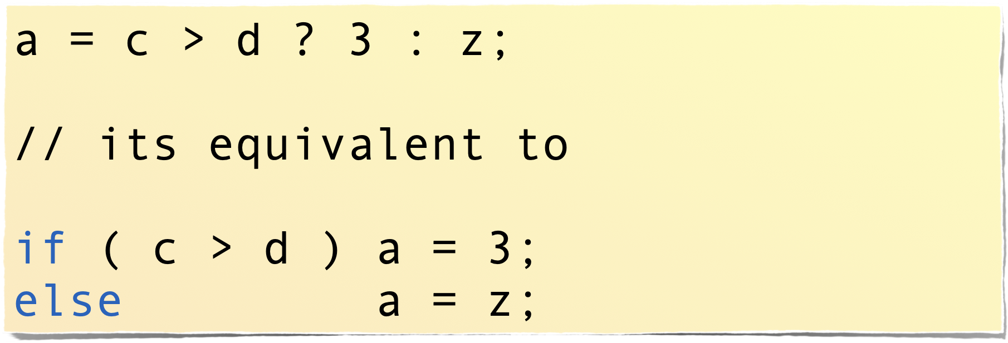
Inline/embedded “IF”
Master ADBoT - May 2019
Enrico Bertolazzi

Slide 22
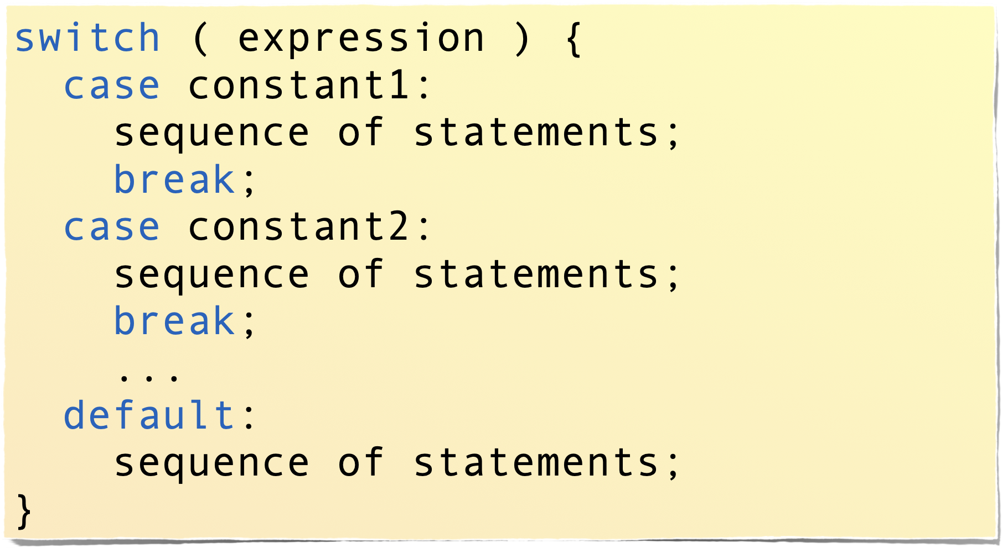
Switch statement
switch statements can be nested
Master ADBoT - May 2019
Enrico Bertolazzi

Slide 23
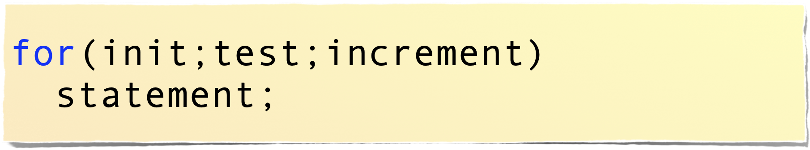
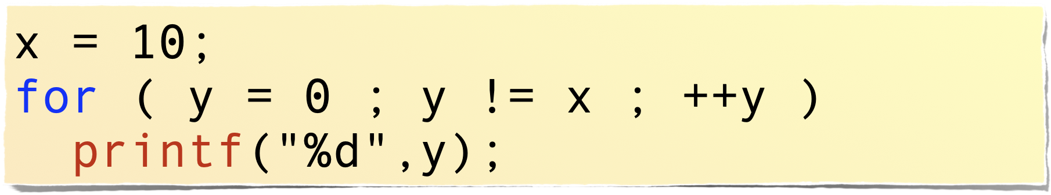
For cycle
Example
Master ADBoT - May 2019
Enrico Bertolazzi

Slide 24

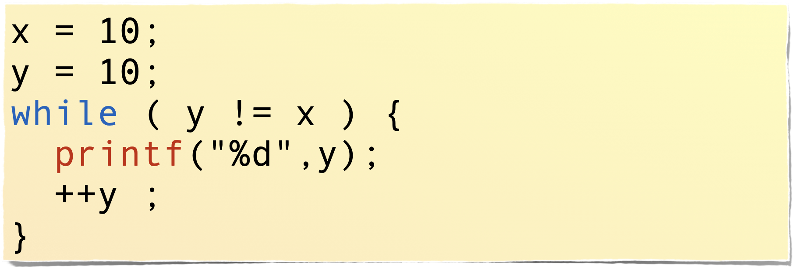
While cycle
Example
Master ADBoT - May 2019
Enrico Bertolazzi

Slide 25
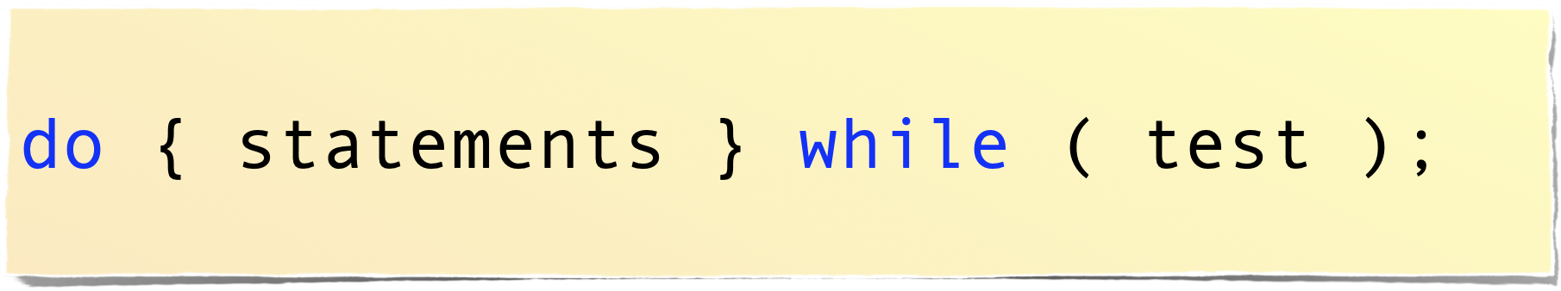
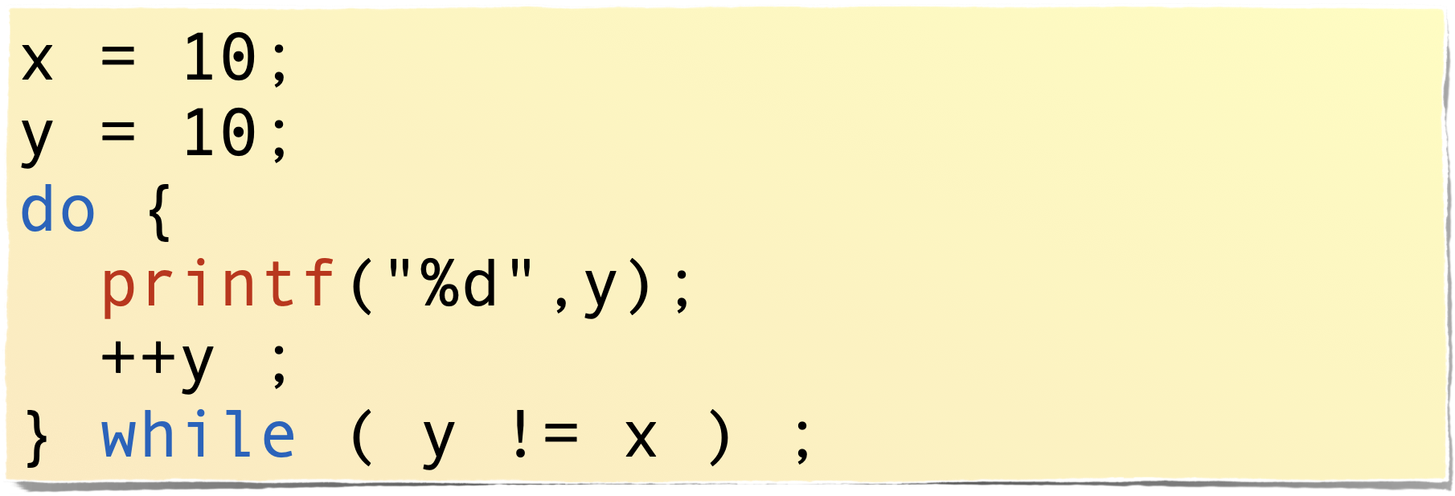
Do cycle
Example
In do-while cycle the test is done at the end, thus at least one cycle is performed
Master ADBoT - May 2019
Enrico Bertolazzi

Slide 26
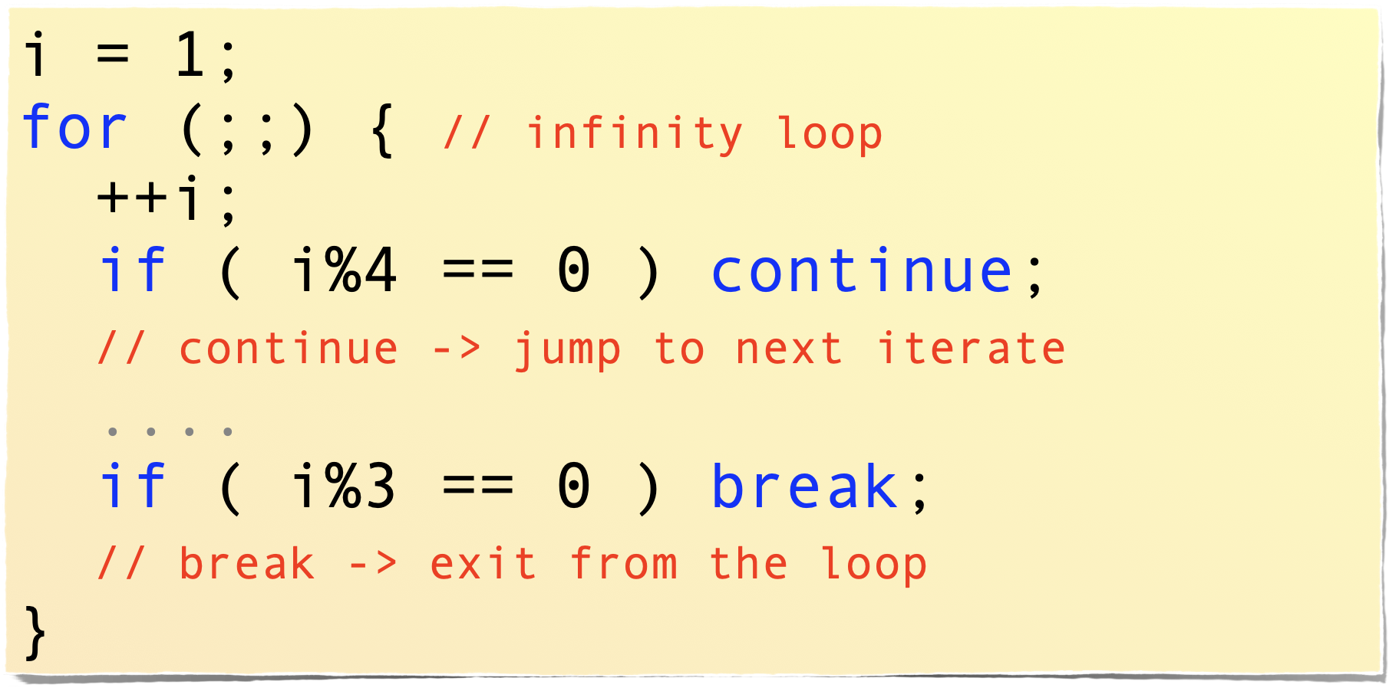
Early exit from the loop
any cycle can be modified by using break and continue
Master ADBoT - May 2019
Enrico Bertolazzi

Slide 27
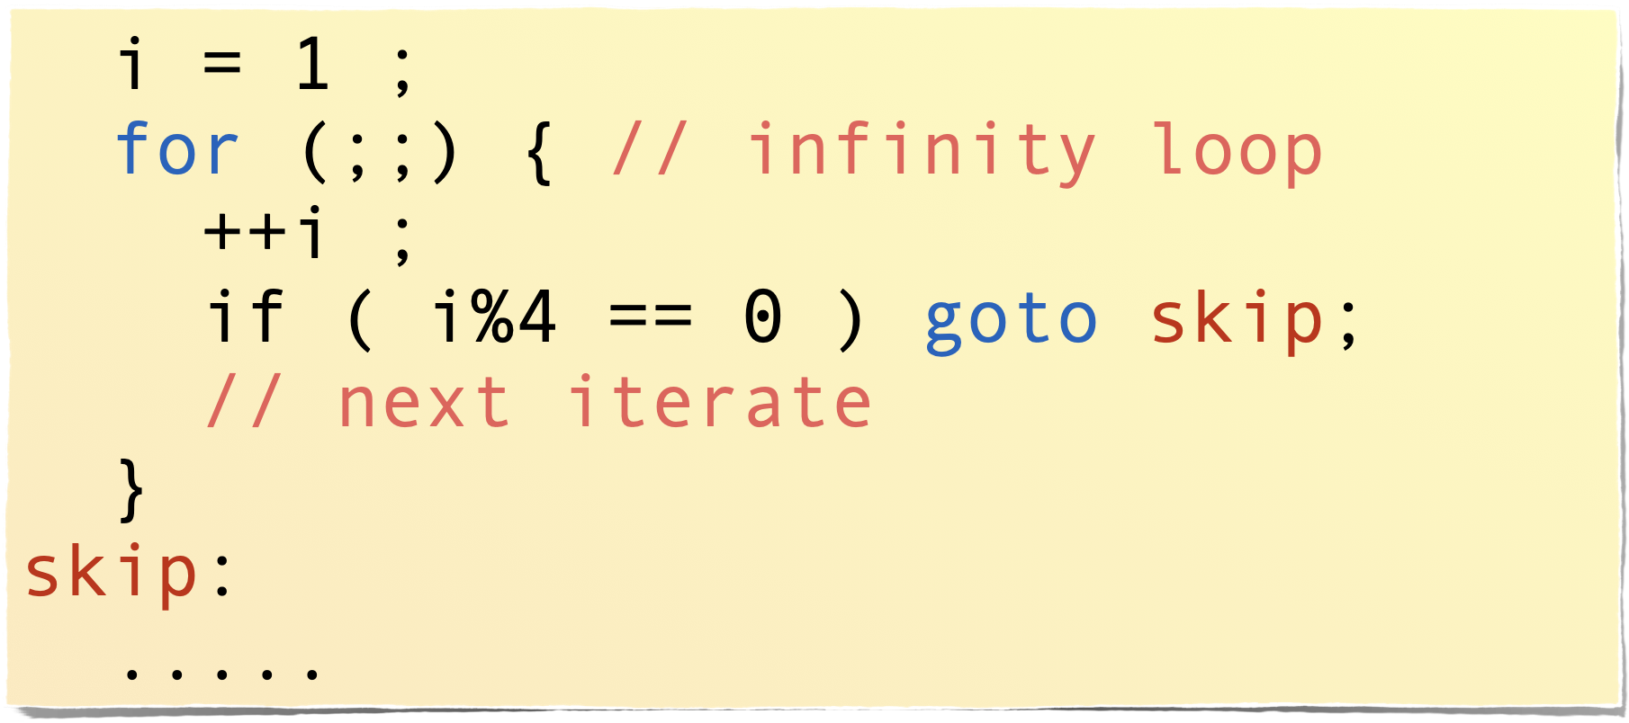
Last resource “goto”
any cycle can be modified by using break and continue
Master ADBoT - May 2019
Enrico Bertolazzi

Slide 28
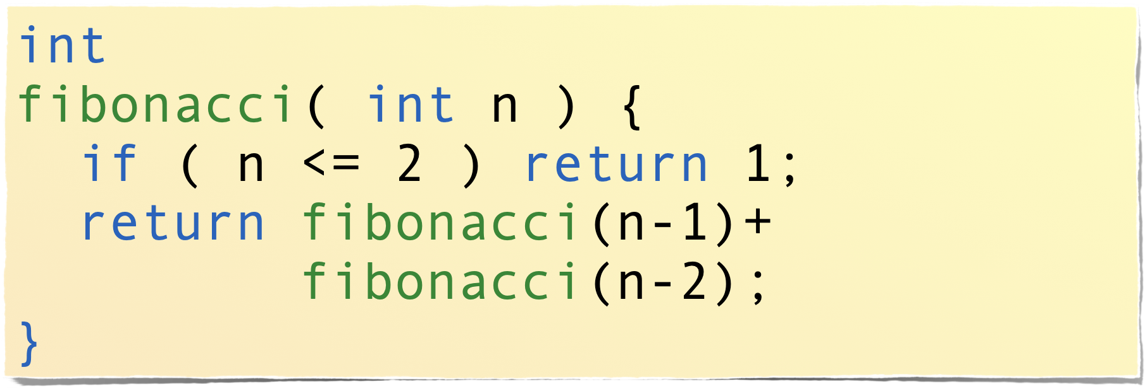
return (from a function)
Normally placed at the end of a function to return the computed value
Can be put everywhere in the code
in case the function is declared void, return is used without arguments
Master ADBoT - May 2019
Enrico Bertolazzi

Slide 29

vector and pointers
Master ADBoT - May 2019
Enrico Bertolazzi

Slide 30
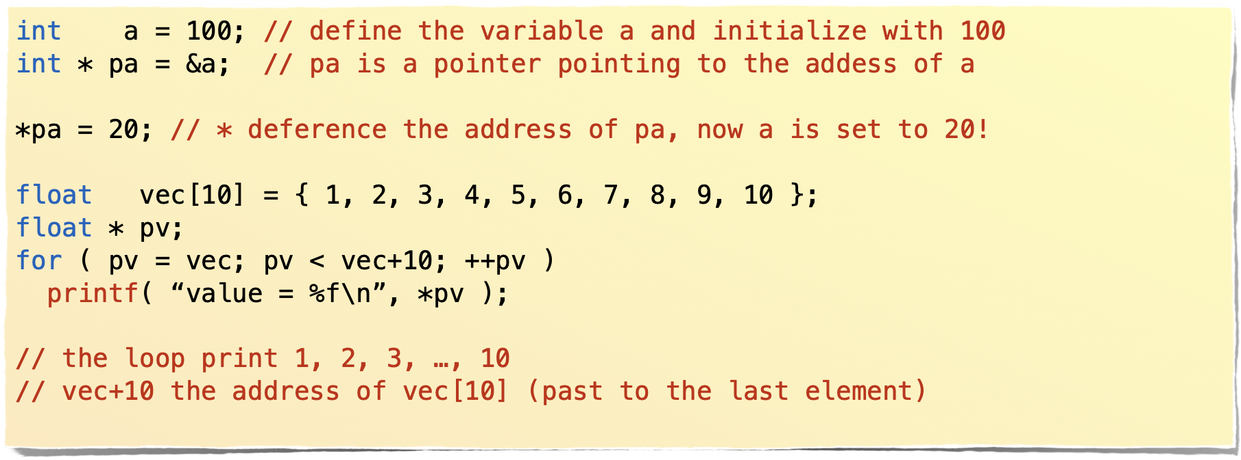
Pointers
Pointers are variable that store the address of a data, not the data itself
Master ADBoT - May 2019
Enrico Bertolazzi

Slide 31
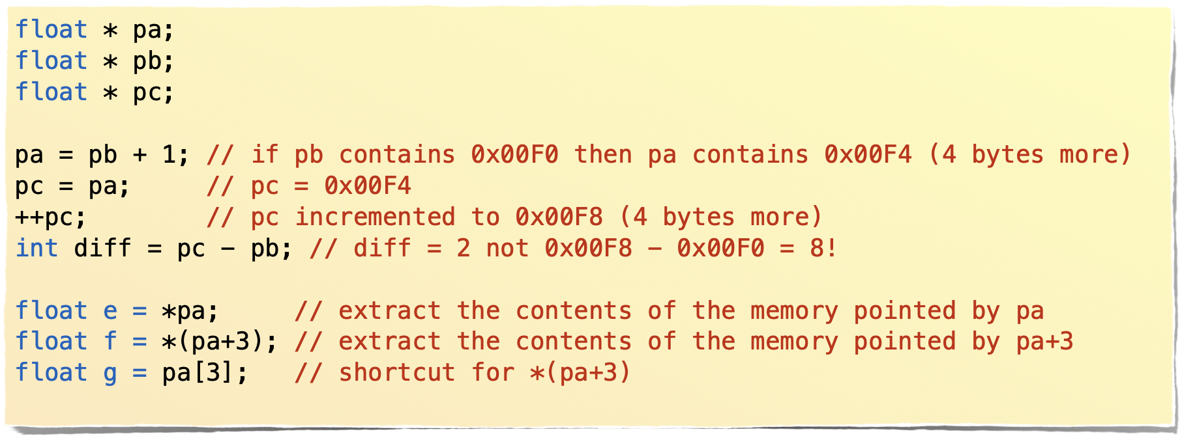
Pointers arithmetics
Pointers can be moved compared etc
Master ADBoT - May 2019
Enrico Bertolazzi

Slide 32
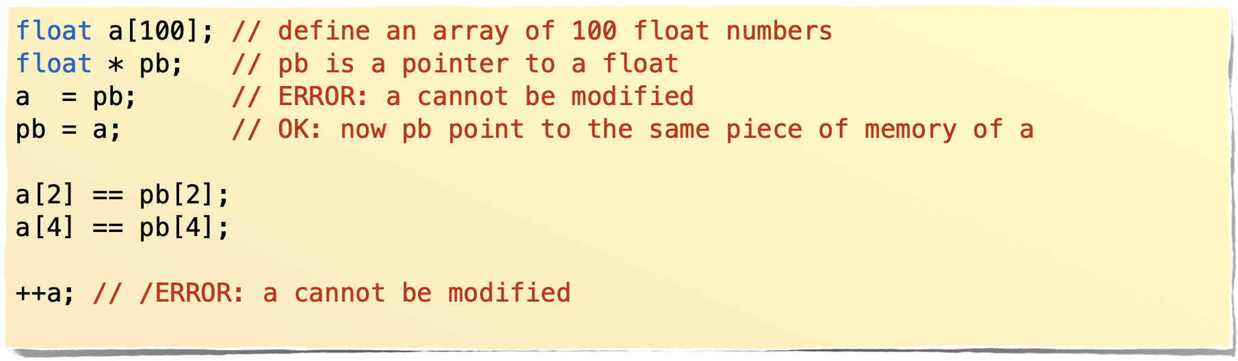
Arrays are special pointers
Vectors/array are pointer to a block of memory. This pointer is not modifiable
Master ADBoT - May 2019
Enrico Bertolazzi

Slide 33


STRINGS
Master ADBoT - May 2019
Enrico Bertolazzi

Slide 34
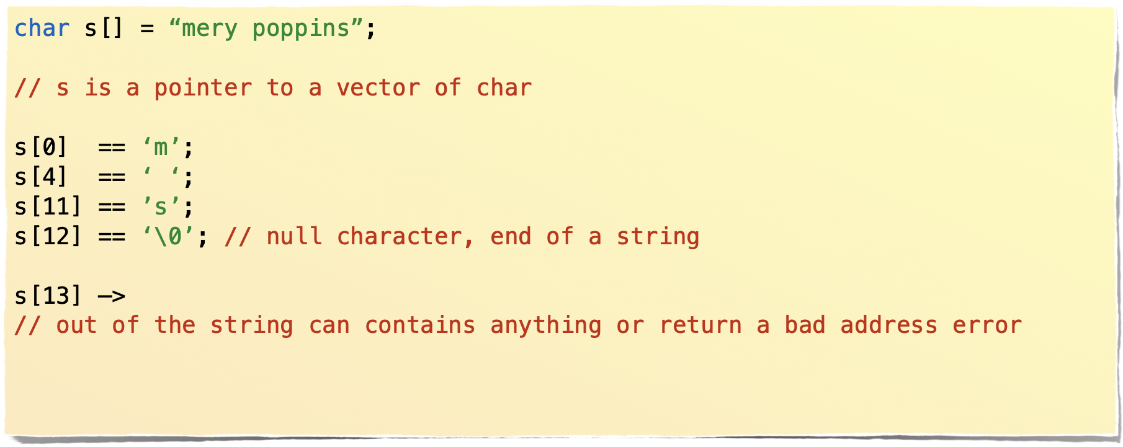
String are pointers to char..
String are not native in C, are simply a pointer to memory that contains characters null terminated
Master ADBoT - May 2019
Enrico Bertolazzi

Slide 35
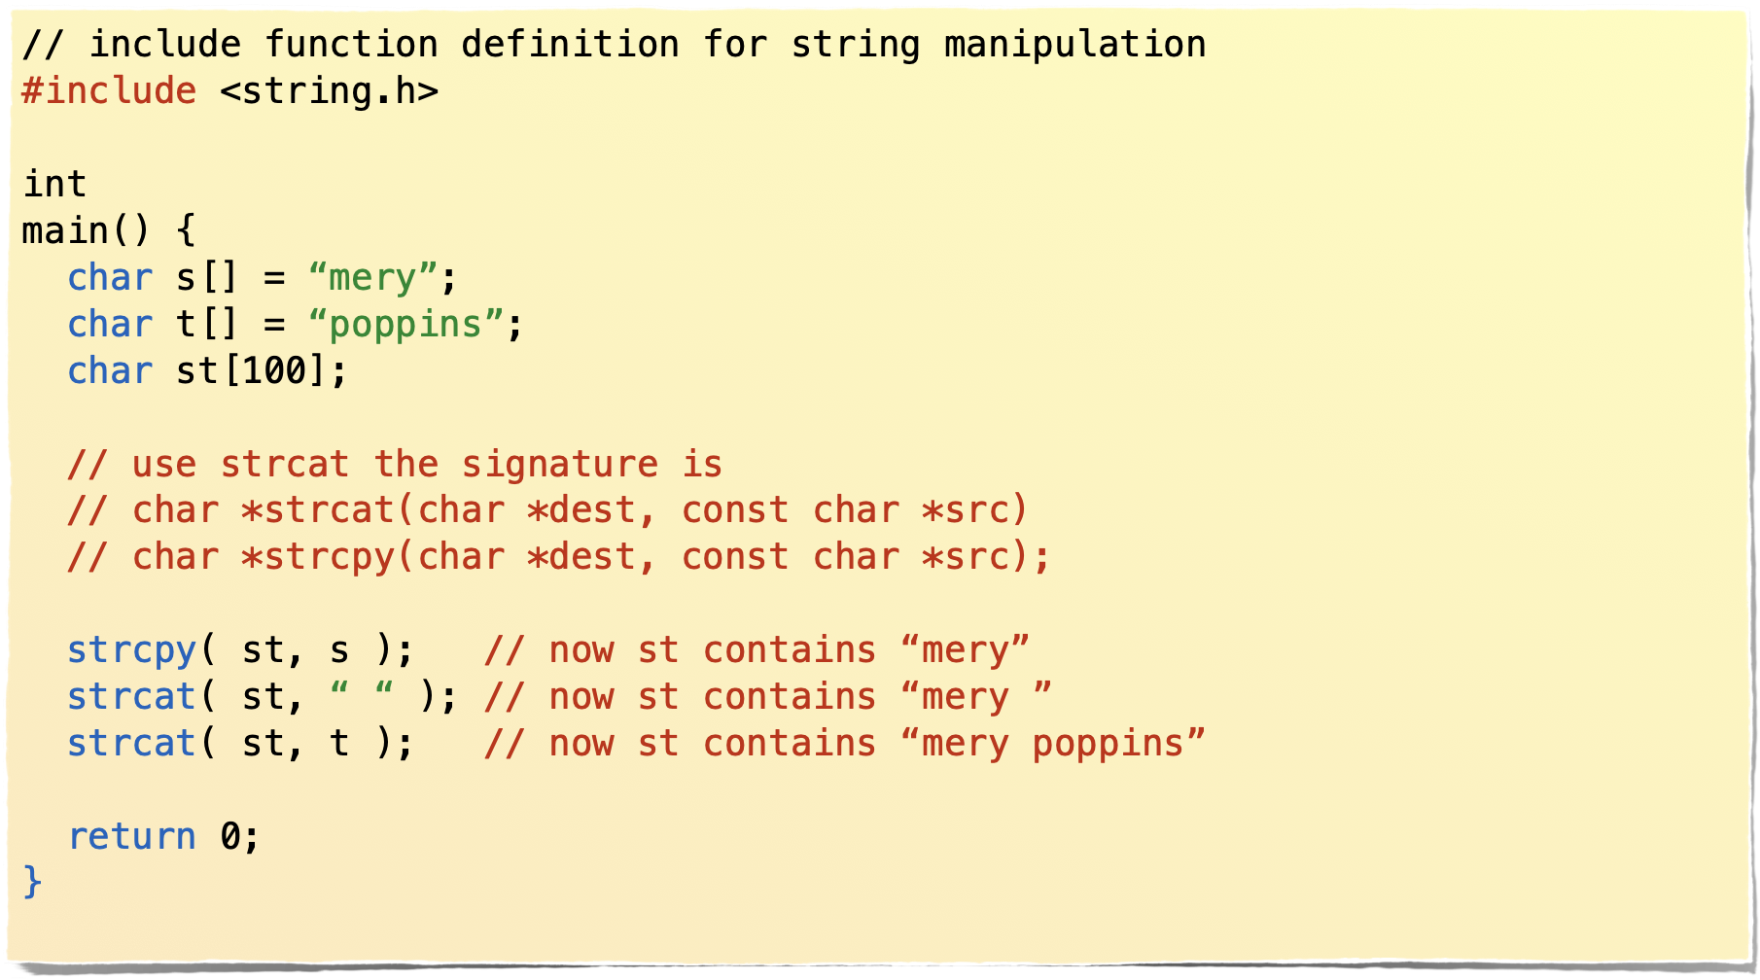
String operation are contained in the standard C library
String operations are function of the standard C library.
To access the library include the header string.h
Master ADBoT - May 2019
Enrico Bertolazzi

Slide 36
Principal string operation
String operations are function of the standard C library.
To access the library include the header string.h
char *strcpy(char *dest, const char *src);
copy the string src to dest (no memory check)
char *strcat(char *dest, const char *src);
append the string src to dest
int strcmp(const char * a, const char * b);
compare the contents of string a with string b. Return -1 if a < b, +1 if a > b and 0 if a == b.
size_t strlen(const char *s);
return the length of the string s, size_t is normally unsigned in
char *strstr(const char *str, const char *substr)
return the pointer of the first match of substr in str, if there is no match return NULL, the null pointer
Master ADBoT - May 2019
Enrico Bertolazzi

Slide 37

TYPEDEF AND NEW TYPES
Master ADBoT - May 2019
Enrico Bertolazzi

Slide 38
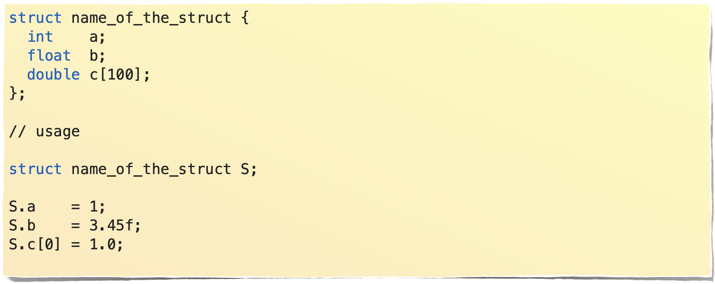
Struct
Struct is a way to collect many types in one object
Master ADBoT - May 2019
Enrico Bertolazzi

Slide 39
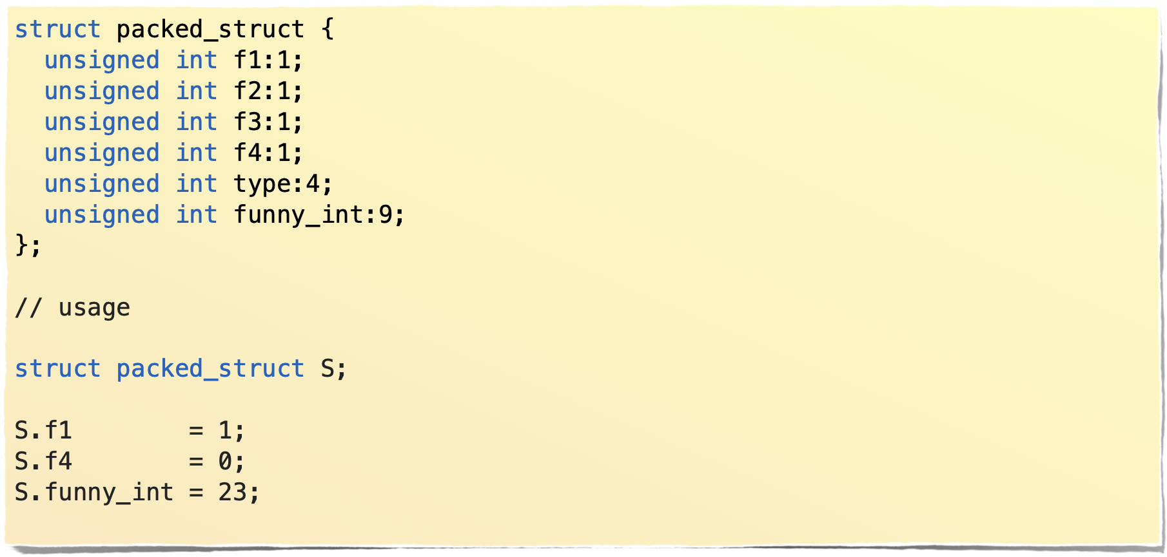
Bitfieds
In a struct you can access integer data using portion of bits.
Its better to use bit manipulation…
Master ADBoT - May 2019
Enrico Bertolazzi

Slide 40
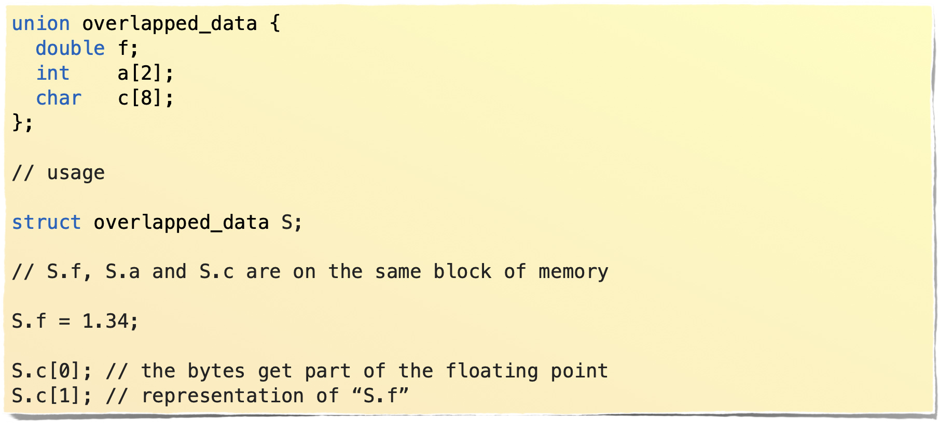
Unions
Sometimes is useful to view the same portion of memory as different types.
Master ADBoT - May 2019
Enrico Bertolazzi

Slide 41
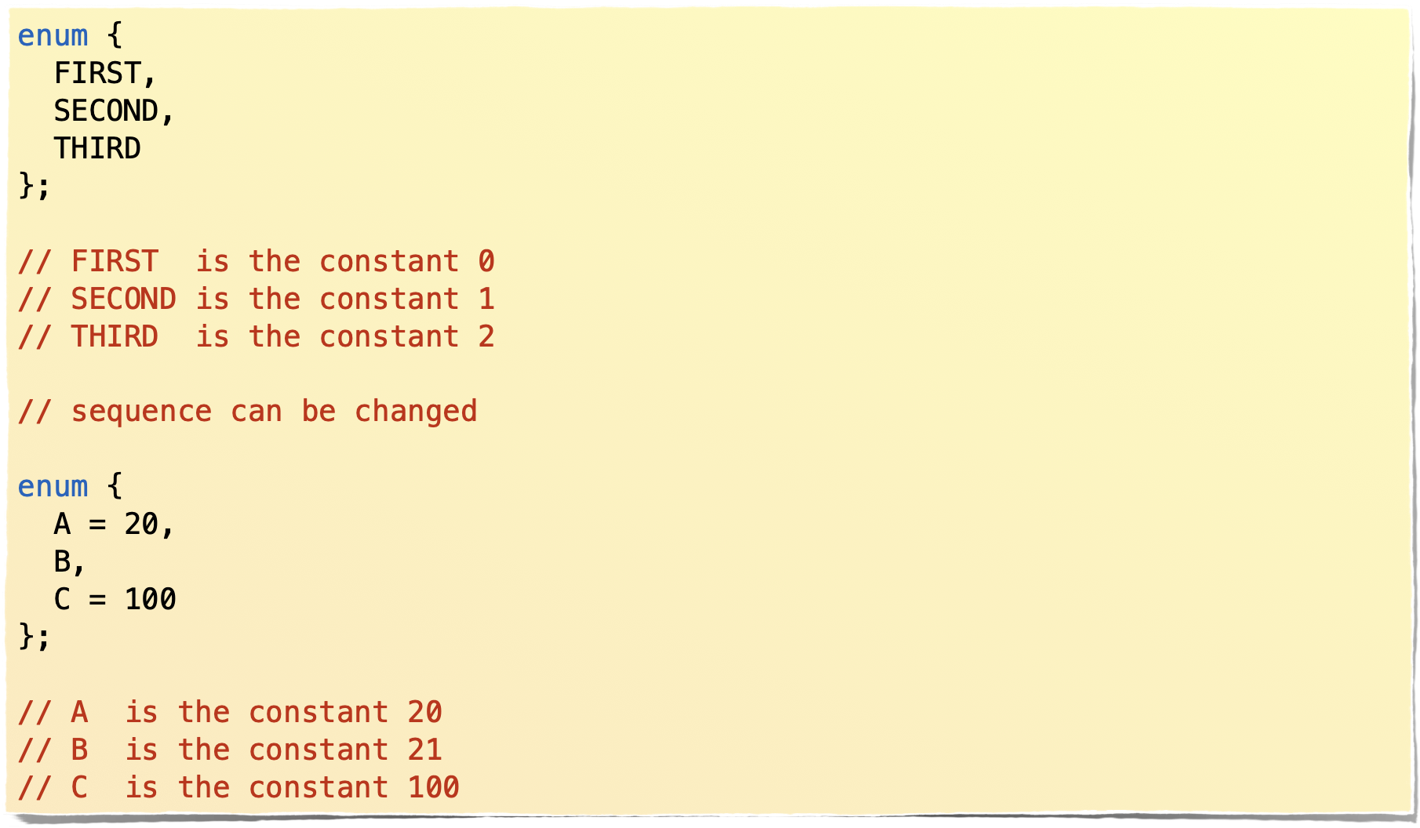
Enum
Sometimes it is useful have a sequence of number stored on variables that cannot be changed
Master ADBoT - May 2019
Enrico Bertolazzi

Slide 42
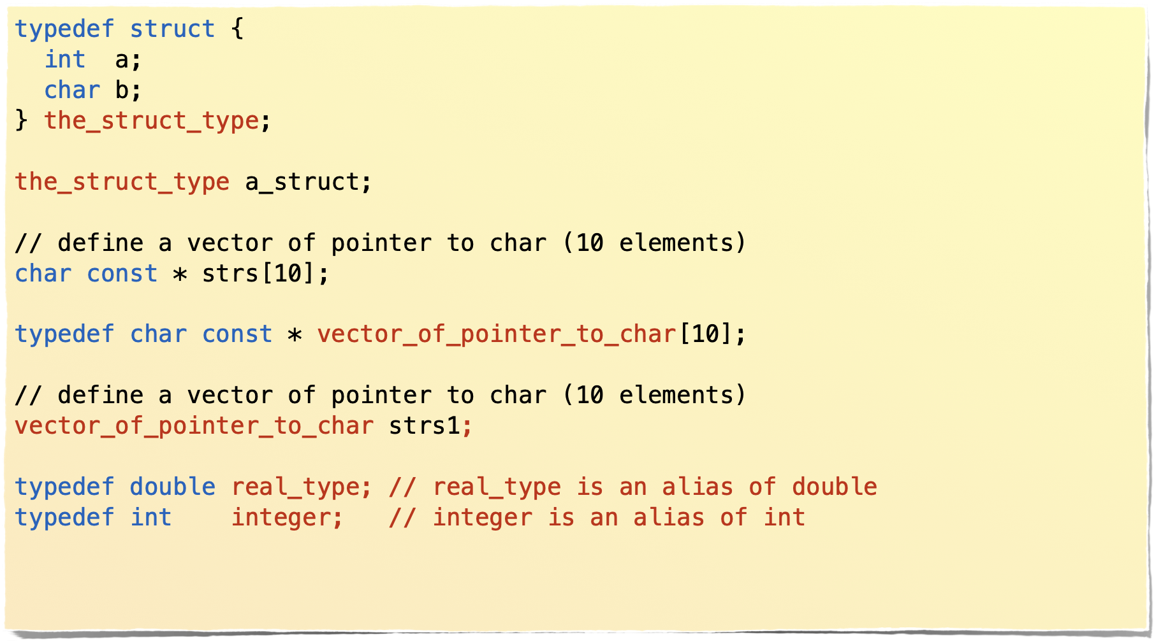
typedef
Complex data type have long declaration, typedef make an alias
Master ADBoT - May 2019
Enrico Bertolazzi

Slide 43

CASTING
Master ADBoT - May 2019
Enrico Bertolazzi

Slide 44
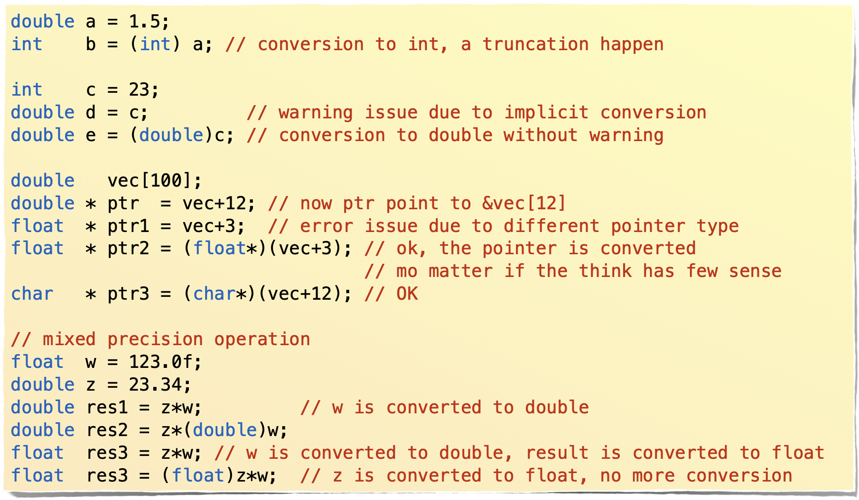
cast operator
Sometime you need to change a type to another type
Master ADBoT - May 2019
Enrico Bertolazzi

Slide 45
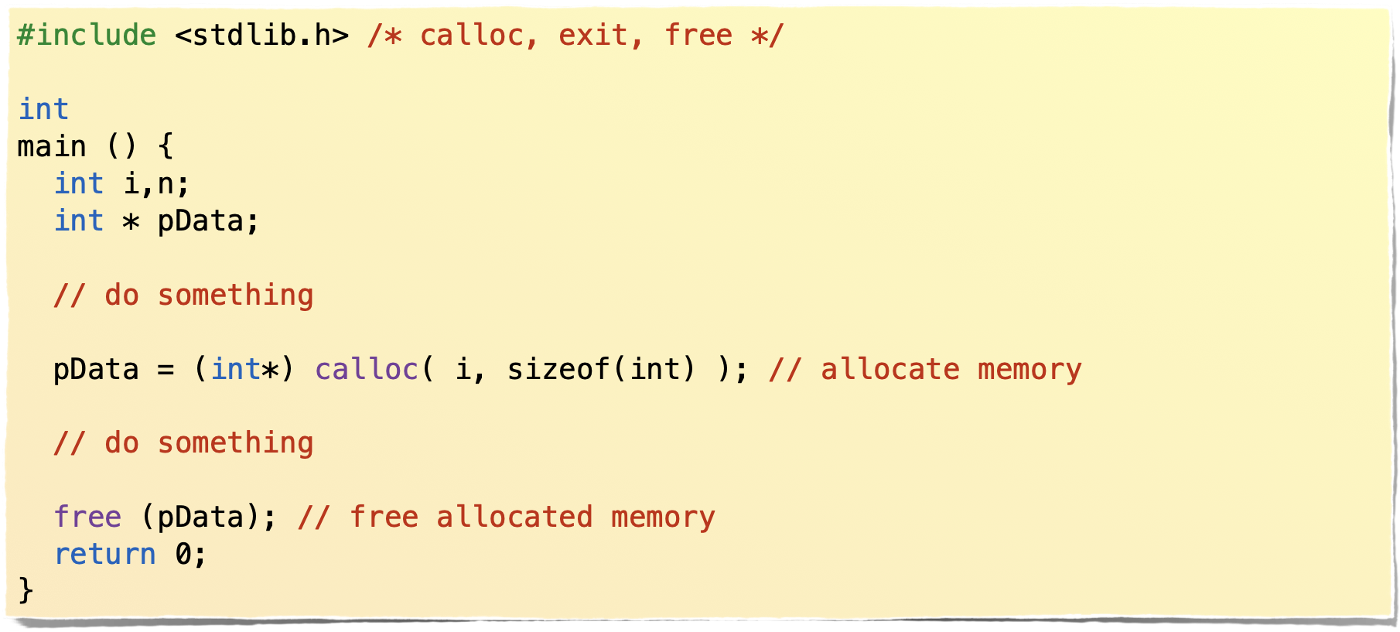
cast operator
Casting is mandatory for dynamic allocation
Master ADBoT - May 2019
Enrico Bertolazzi

Slide 46
SPLIT YOUR CODE IN Many FILES
Master ADBoT - May 2019
Enrico Bertolazzi

Slide 47
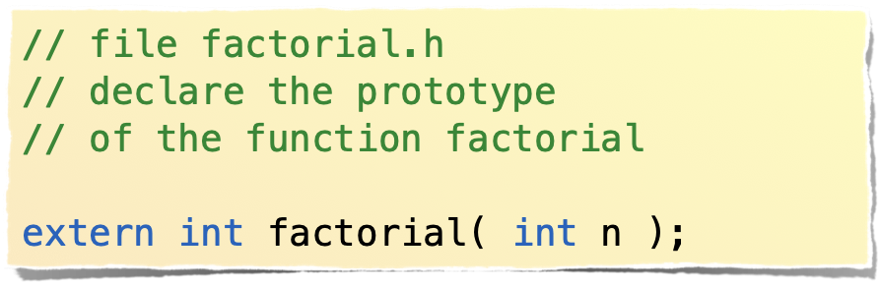
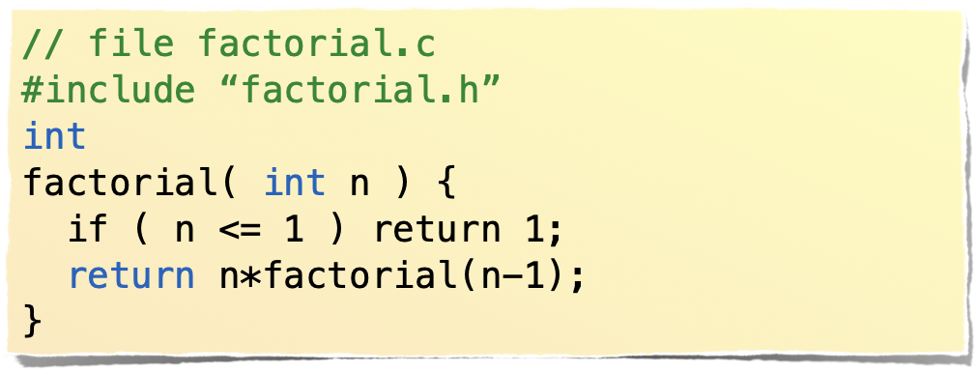

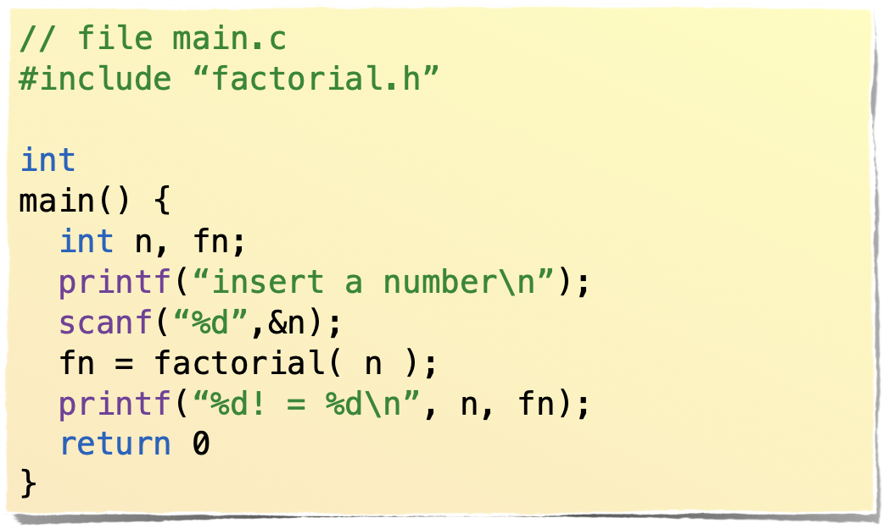


Use header to define prototype
A good library split code and header with
the prototype of the library functions
header file declaring
the prototype
of function factorial
body file implementing
the function factorial
main program that use
the function factorial
Master ADBoT - May 2019
Enrico Bertolazzi

Slide 48
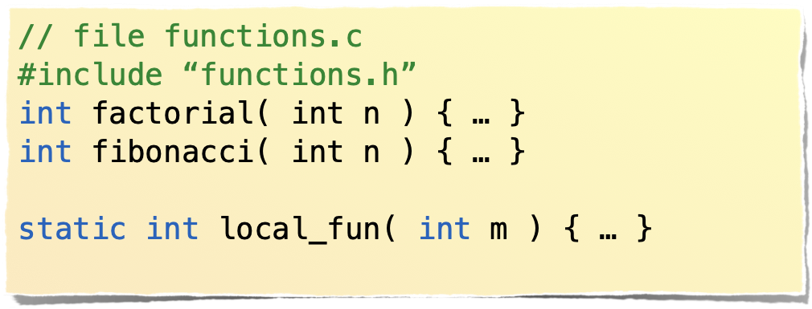
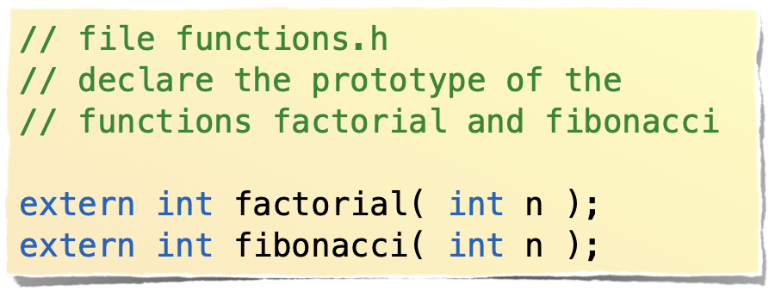
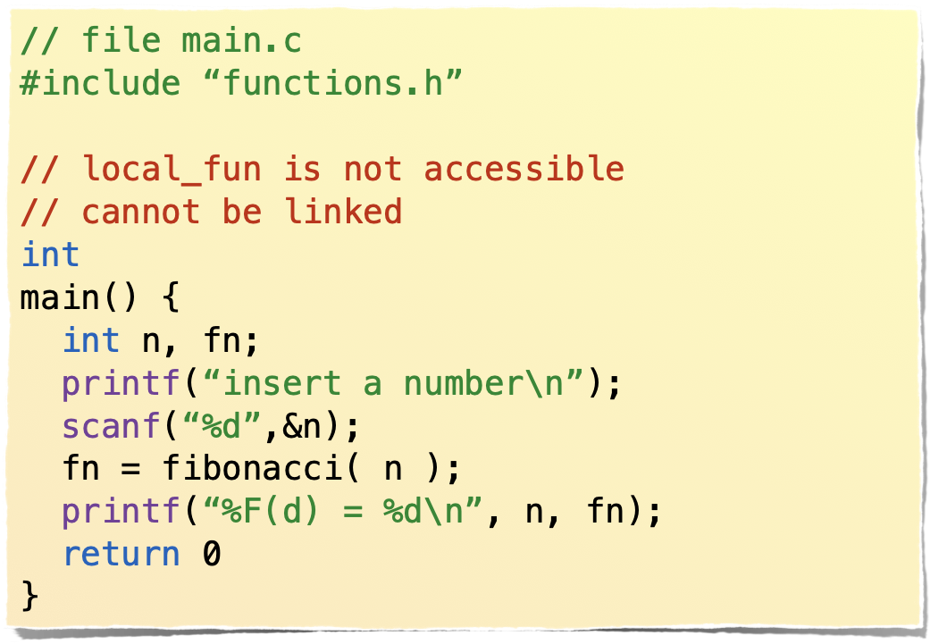

extern/static
extern tell the compiler that a function prototype will be imnplemented in another unit.
header file declaring
the prototypes
body file implementing
the functions
main program that use
the functions
Master ADBoT - May 2019
Enrico Bertolazzi

Slide 49

MEMORY ALLOCATION
Master ADBoT - May 2019
Enrico Bertolazzi

Slide 50
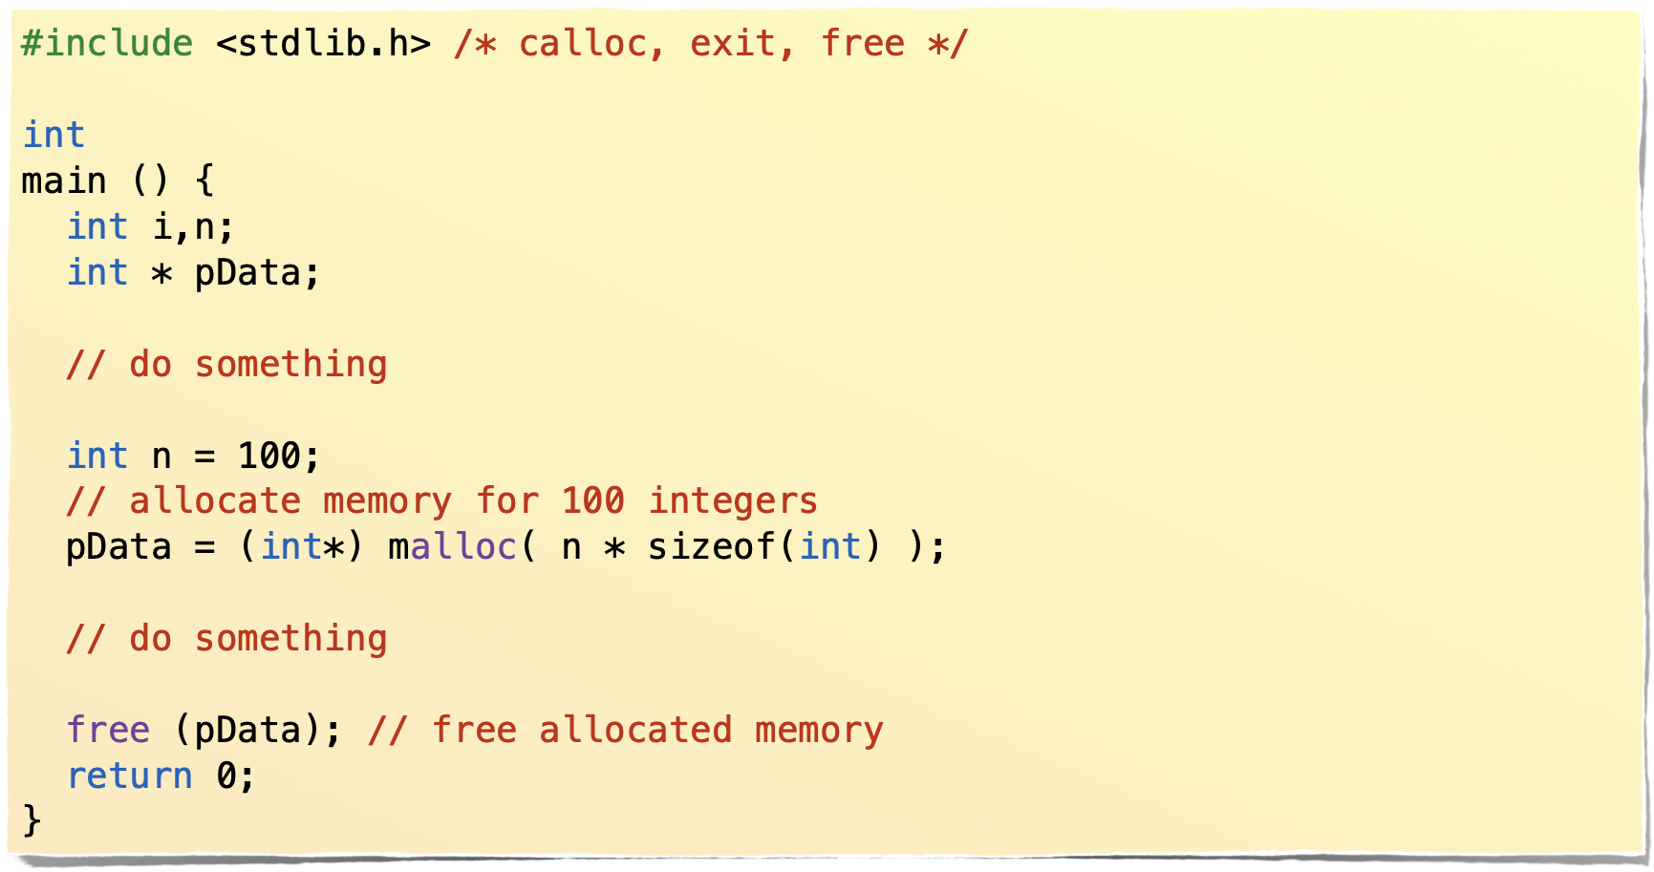
Malloc/free
Often a program cannot known in advance the memory requirements
Master ADBoT - May 2019
Enrico Bertolazzi

Slide 51
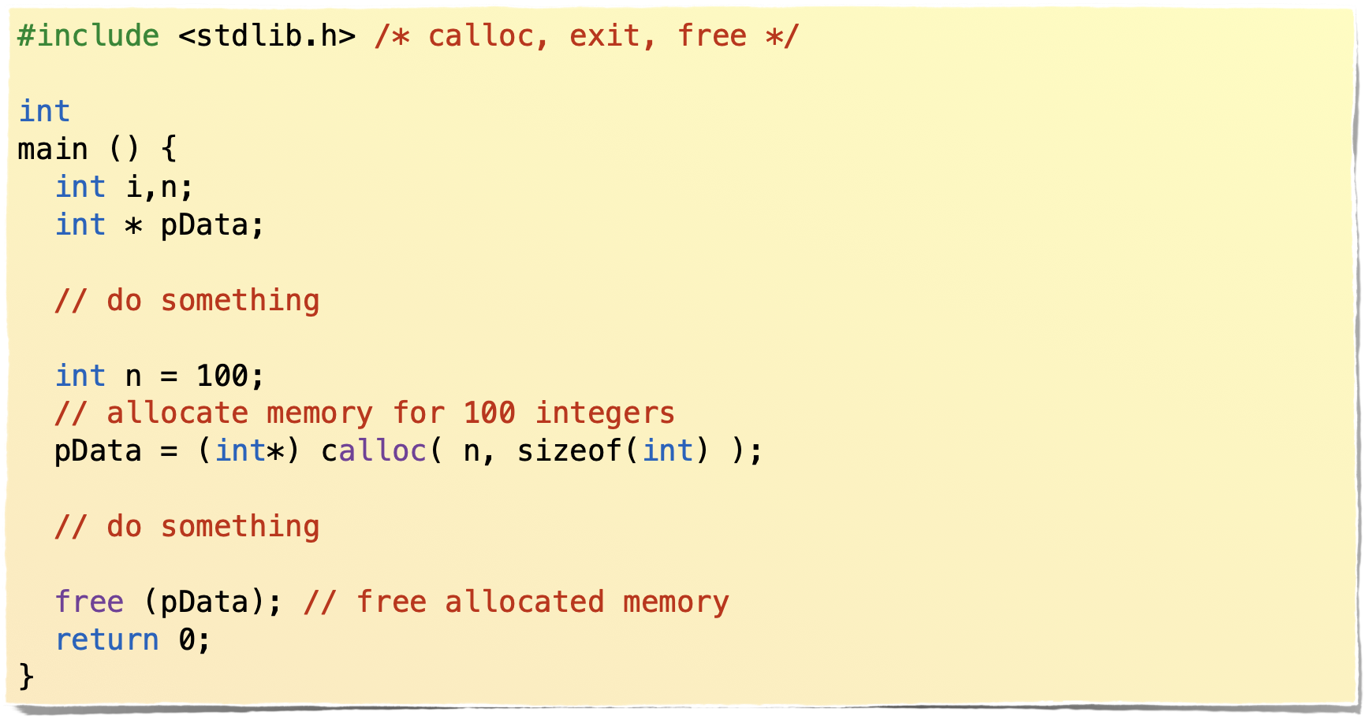
Calloc/free
Often a program cannot known in advance the memory requirements
Master ADBoT - May 2019
Enrico Bertolazzi

Slide 52
Principal memory allocation functions
Function | Purpose
malloc( n ) | allocate memory for a block of n bytes, retrun a pointer to the memory block
realloc( ptr, n ) | loically equivalent to free(ptr) followed by malloc( n )
calloc( n, size ) | equivalent to malloc( n * size ) followed by a zero initialize of the block of memory
free( ptr ) | free the allocated memory pointer by ptr. If ptr point to a NOT allocated piece of memory an error is issued
Master ADBoT - May 2019
Enrico Bertolazzi

Slide 53

ARGUMENTS FOR MAIN
Master ADBoT - May 2019
Enrico Bertolazzi

Slide 54




Argument for main
A compiled C code is a command for the OS that may use argument. Like ls -l, ps -e, cat pippo…
The syntax is
int main( int argc, char const argv[] ) { … }
A vector of pointer to C-strings. For example
cmd arg1 arg2
argc[0] point to “cmd” argc[1] point to “arg1”
argc[2] point to “arg2”
An integer containing
the number of argument passed. For example
cmd arg1 arg2
argc = 3
Master ADBoT - May 2019
Enrico Bertolazzi

Slide 55
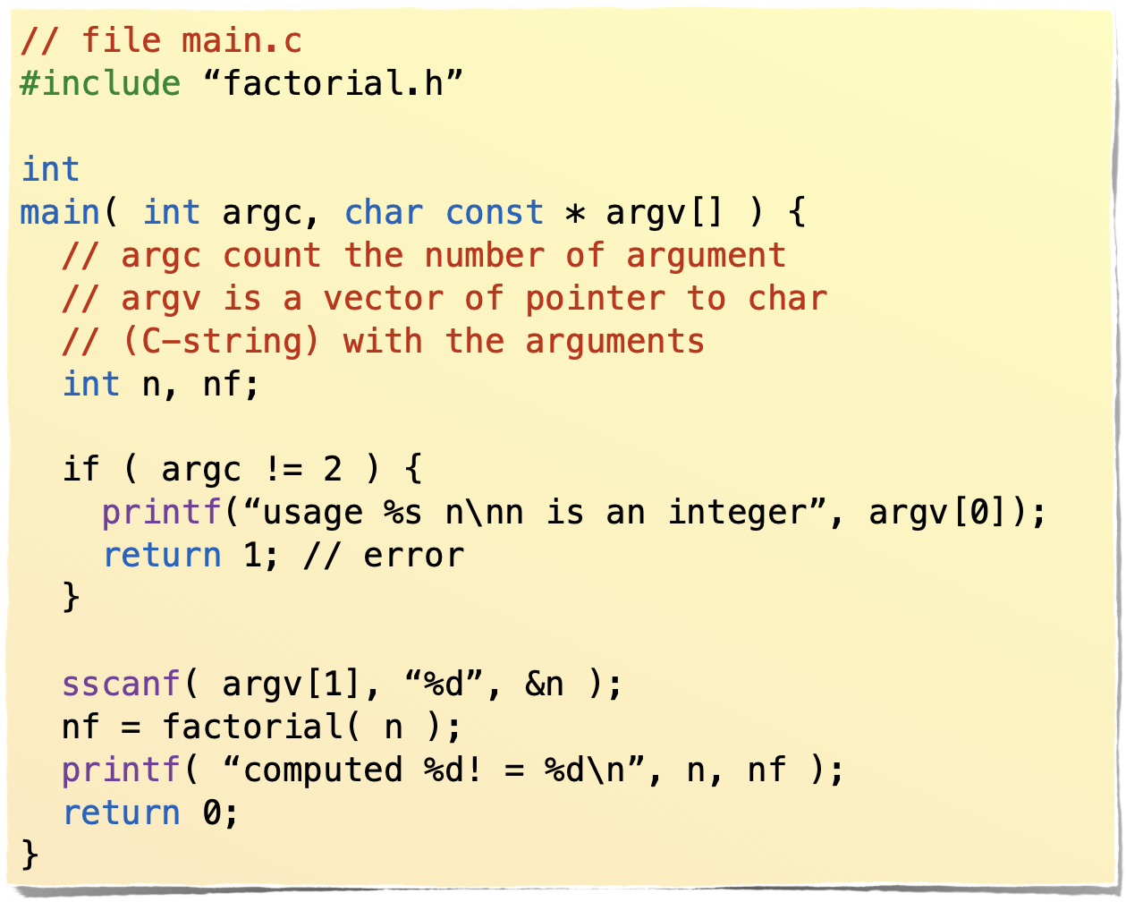
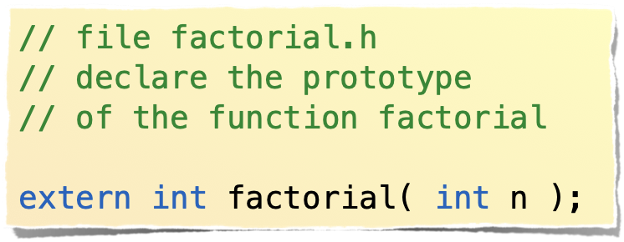



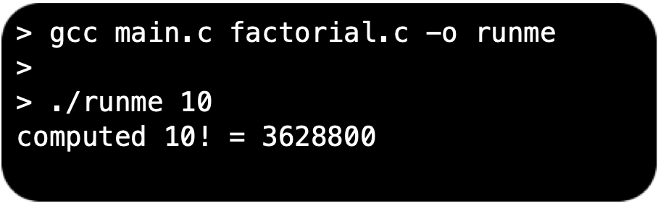
Argument for main
A compiled C code is a command for the OS that may use argument. Like ls -l, ps -e, cat pippo…
header file with the prototype
main program
compile link and execute
Master ADBoT - May 2019
Enrico Bertolazzi

Slide 56

THE I/O
Master ADBoT - May 2019
Enrico Bertolazzi

Slide 57
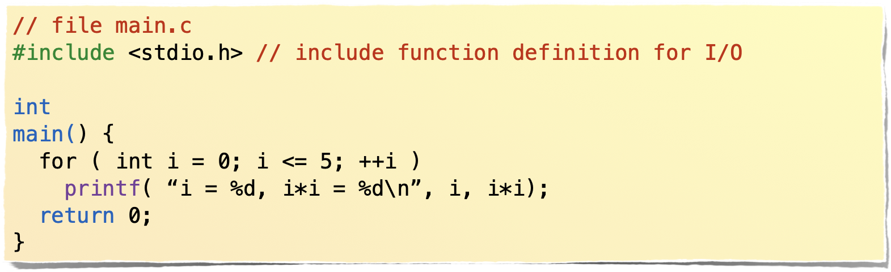
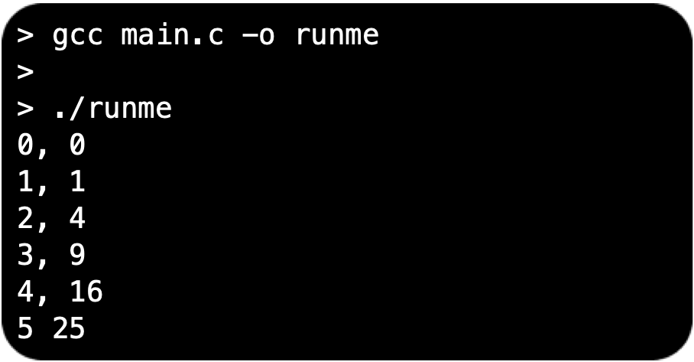
printf = print formatted
I/O is done by function library
printf write on standard output with formatting.
The argument are formatted
using %CODE where CODE is how the arguments is maniopulated
Master ADBoT - May 2019
Enrico Bertolazzi

Slide 58
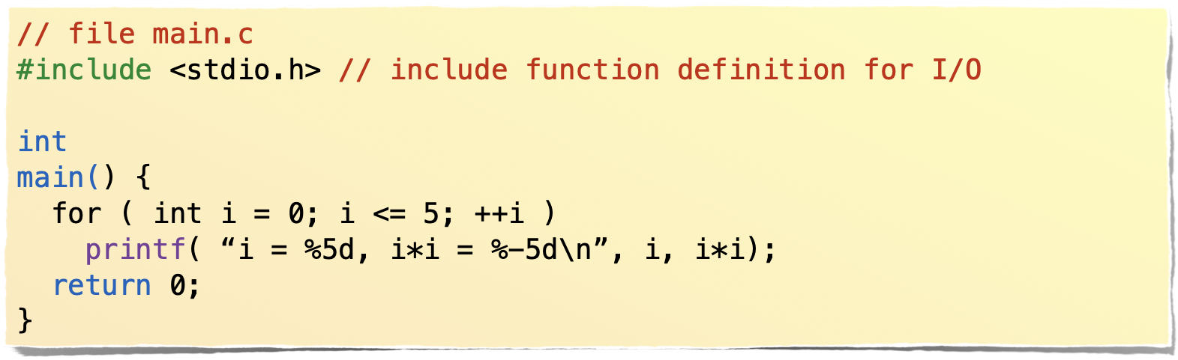
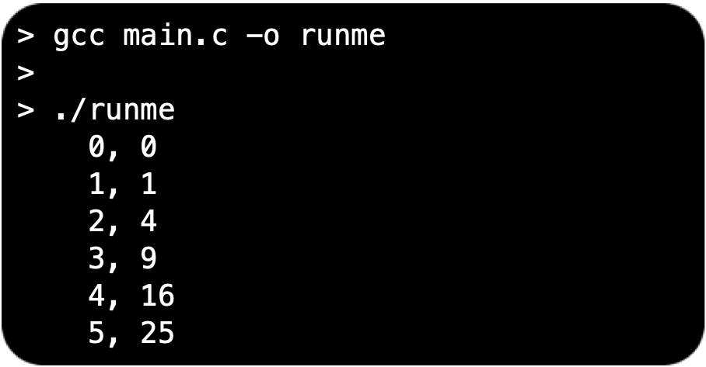
printf = print formatted
I/O is done by function library
%d means format an integer
as a decimal number
%5d reserve 5 space for printing
%-5d also left justify
Master ADBoT - May 2019
Enrico Bertolazzi

Slide 59
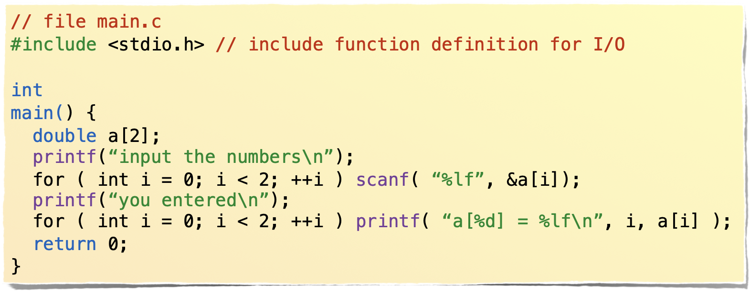
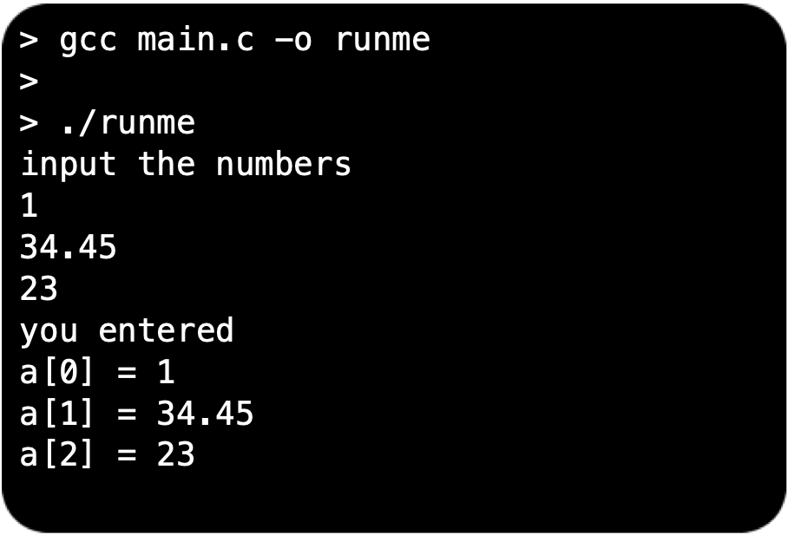
scanf
Master ADBoT - May 2019
Enrico Bertolazzi

Slide 60
printf/scanf formatting codes
The formatting is done by % followed by a letter
%d = decimal number
%f = float number (%lf for double)
%e = float formatted using exponential form 0.0012f = 1.2e-3 %le = double formatted using exponential form 0.0012 = 1.2e-3 %g = float formatted normally or exponential, choose the better looking (%lg for double)
%[n] reserve n character for the print, for example printf(“*%5g*\n”, 12.5f) print
*__12.5* (two more space on the left)
%- left align, for example printf(“*%-5g*\n”, 12.5f) print *12.5__* (two more space on the right)
for a full list of the formatting code read at
http://www.cplusplus.com/reference/cstdio/printf/?kw=printf
http://www.cplusplus.com/reference/cstdio/scanf/?kw=scanf
Master ADBoT - May 2019
Enrico Bertolazzi

Slide 61
I/O on a file/string
printf and scanf can be used to read and write not only on the terminal but on a file or on a string.
To write on a file, first of all open a file FILE * fd = fopen(“filename”,”w”) fprinf( fd, “THE FORMAT”, THE DATA ); fclose( f );
To read from a file, first of all open a file FILE * fd = fopen(“filename”,”r”) fscanf( fd, “THE FORMAT”, THE DATA ); fclose( f );
The same can be done on a string using sprinf, sscanf char str[100]; int a = 100; sprinf( str, “Number = %d”, a ); double n; sccanf( “123.45”, “%lf”, &n);
Master ADBoT - May 2019
Enrico Bertolazzi

Slide 62
Principal I/O functions
Principal function for the I/O, must include
#include <stdio.h>
Write | Read
printf | scanf
fprintf | fscanf
sprintf | sscanf
Open file | Close file
fopen | fclose
Master ADBoT - May 2019
Enrico Bertolazzi

Slide 63

THE preprocessor
Master ADBoT - May 2019
Enrico Bertolazzi

Slide 64
Preprocessor
C is a compiled language, it means that the source code is translated to machine code and linked with system/user libraries to produce an executable (or another library)
Before to start the compiling phase (the translation of the C code to a machine code) the source code is processed/filtered by preprocessor that produce a new source code
Preprocessor is used normally to include definition and prototype from system and user libraries but the macros mechanism permits to use conditional programming so that the same source code can adapt to work well on different architectures or operative systems.
Macros are widely used to produce “inline” functions or named constants
Master ADBoT - May 2019
Enrico Bertolazzi

Slide 65
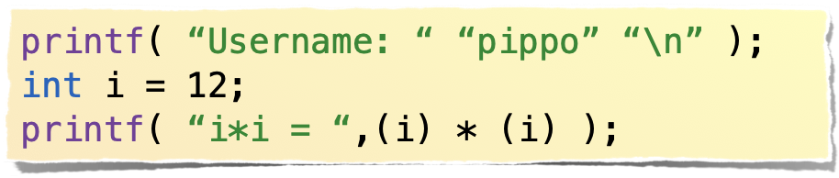
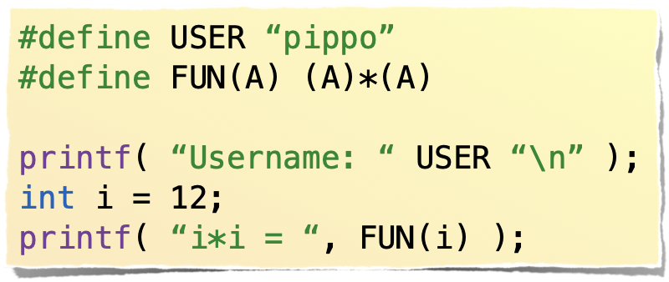


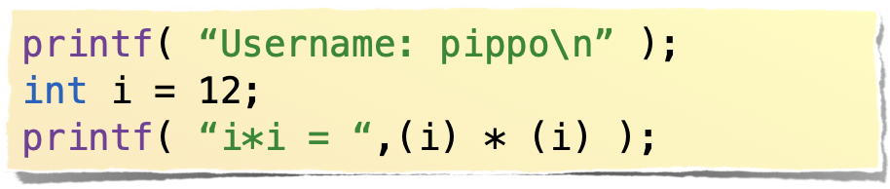
#define
#define MACRO_NAME
The preprocessor define the macros MACRO_NAME every time it find the string MACRO_NAME is replaced with the text on the right in this case nothing.
#define MAX(A,B) ( (A) > (B) ? (A) : (B) )
In when the compiler find MAX(i+1,j-1) replace with ( (i+1) > (j-1) : (i+1) : (j-1) )
#define NAME_USER “pippo”
In when the compiler find NAME_USER replace with “pippo”
after preprocessing
before preprocessing
consecutive constant strings
are concatenated
Master ADBoT - May 2019
Enrico Bertolazzi

Slide 66
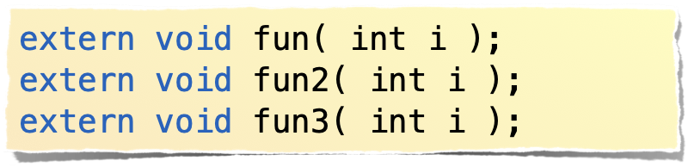



#include
#include “filename”
The preprocessor read the file “filename” and expand as is written in the same place
#include <filename>
same as previous but “filename” is searched in system directories Normally /usr/include but depend on the OS or the compiler
file a_file.h
after preprocessing
before preprocessing
Master ADBoT - May 2019
Enrico Bertolazzi

Slide 67





#ifdef #ifndef #else #endif
#ifdef SOMETHING
expand the block is SOMETHING is a defined macros
#ifndef SOMETHING
expand the block is SOMETHING is NOT a defined macros
after preprocessing
and PIPPO is defined
before preprocessing
after preprocessing
and PIPPO is NOT defined
Master ADBoT - May 2019
Enrico Bertolazzi

Slide 68




Avoid double inclusion trick
file.h
after preprocessing
before preprocessing
Master ADBoT - May 2019
Enrico Bertolazzi

Slide 69
OTHER PREPROCESSOR COMMAND
#if defined(MACRO) is the same of #ifdef MACRO, but can combine things more complex
#if defined(A) && !define(B)
#elseif used in the #ifdef block
#line NUMBER change the line number used in the debug message
#pragma pass special command to the compiler, its compiler dependent. Read the manual of the compiler for the list of pragmas
#undef MACRO if the macro MACRO is defined will be “cancelled”
Master ADBoT - May 2019
Enrico Bertolazzi

Slide 70
Special preprocessor command
#define A(X) #X #X the # convert symbol to string, in this example A(pippo) is expanded to “pippo” “pippo”
#define CONCAT(B,C) B ## C perform string concatenation, in this example CONCAT(“pippo”,”pluto”) is expanded to “pippopluto”
Predefined macros
__LINE__
__FILE__
__DATE__
__TIME__
__STDC__
more others…
Master ADBoT - May 2019
Enrico Bertolazzi

Slide 71

C standard .h files and libs
Master ADBoT - May 2019
Enrico Bertolazzi

Slide 72
Most used headers
#include <stdio.h> Provides generic file operation support and supplies functions with character input/output capabilities.
#include <stdlib.h> General utilities: memory management, program utilities, string conversions, random numbers
#include <string.h> String manipulation function, (strcpy,strcat, strlen, strstr, tolower, toupper, memcpy, memmove, memset)
#include <math.h> Common mathematics functions, abs, sin, cos, exp, …
#include <limits.h> various macros with limits of standard type, INT_MAX, LONG_MAX,…
#include <stddef.h> Common macro definitions, size_t, ptrdiff_t , NULL
Master ADBoT - May 2019
Enrico Bertolazzi

Slide 73
Compile and link
gcc -O2 -Wall FILE.c -o FILE.o to compile a file and obtain an OBJ file, -Olevel optimization, -Wall activate maximum level of warning (recommended)
gcc FILE1.o FILE2.o … FILEN.o -o EXECUTABLE -lLIB1 -LIB … -lLIBN link files with libraries and produce an executable
-lc = STANDARD LIBRARY of C contain implementation of all the function in the standard headers like printf, scanf, exit, …
-lm = STANDARD MATH LIBRARY of C contain implementation of all math function in the standard headers like sin, cos, exp, …
Master ADBoT - May 2019
Enrico Bertolazzi

Slide 74

END OF CRASH COURSE ON C
http://www.projectcartoon.com
Master ADBoT - May 2019
Enrico Bertolazzi

